Slide 1
Duffing Oscillator
Ph235 Spring 2019
Professor Raja
Andy Jeong

Slide 2
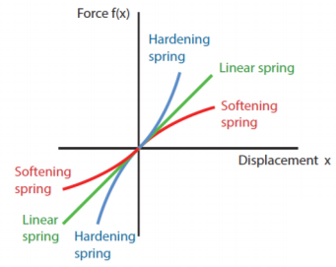
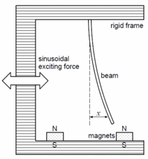
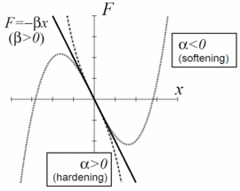
Problem statement
Initial: Model chaotic motion of a magnetoelastic steel beam due to restoring forces, elasticity, damping, excitation, gravity etc.
Modified → examine and identify points of bifurcation through visual aids for softening and hardening duffing oscillator system
Figure 1. For β>0: a forced oscillator model with a spring
whose restoring force is written as F=−βx−αx3
Figure 2. For β<0: a model of a periodically forced steel beam
which is deflected toward the two magnets.
(Moon and Holmes, 1979; Guckenheimer and Holmes, 1983; Ott, 2002)
Notes:
Softening system numerical solution caused some trouble in approximation
So worked with hardening system mostly
Mass = 1 kg

Slide 3
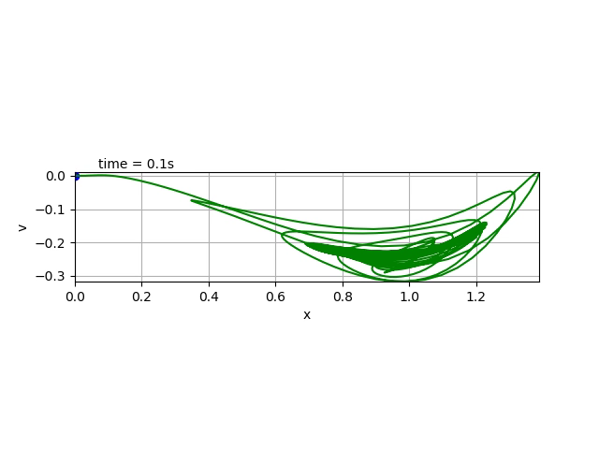
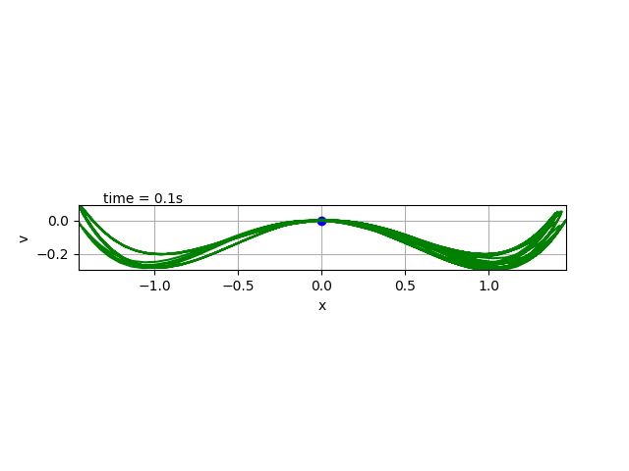
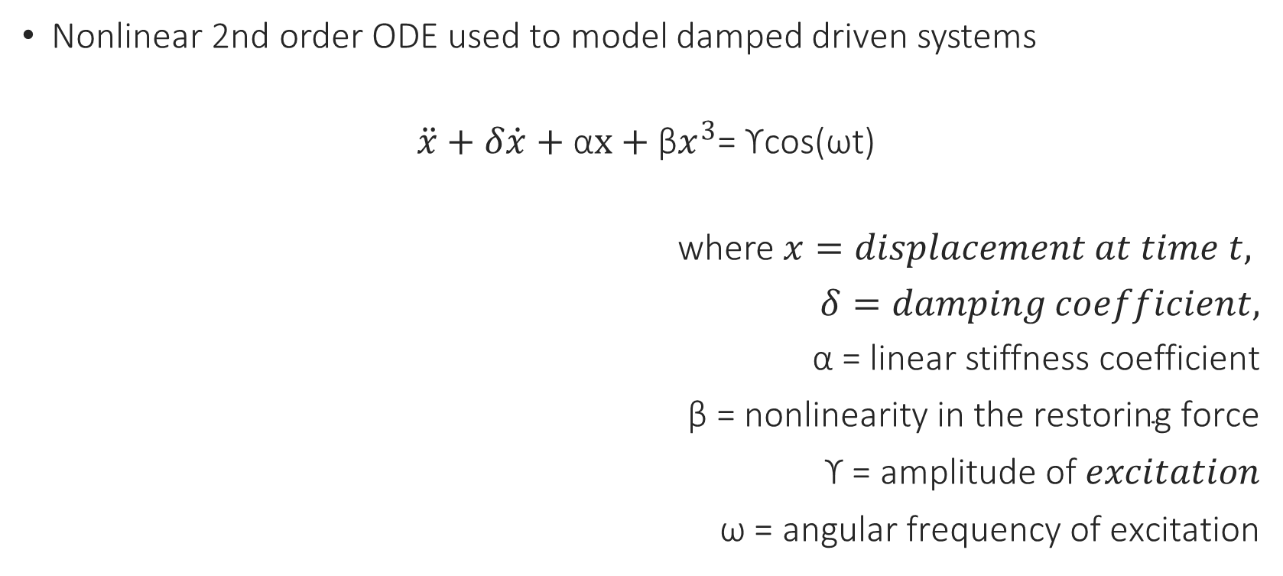
Duffing’s Equation
Nonlinear 2nd order ODE used to model damped driven systems
$\ddot{x}+δ\dot{x}+\text{α}x+{\text{β}x}^{3}$= ϒcos(ωt)
where$x=displacement at time t,$
$δ=damping coefficient,$
$\text{α}\text{ =}$ linear stiffness coefficient
$\text{β}\text{ = }\text{nonlinearity} \text{in} \text{the} \text{restoring} \text{force}$
$\text{ϒ}\text{ = }\text{amplitude} \text{of} excitation$
$\text{ω}\text{ = }\text{angular} \text{frequency} \text{of} \text{excitation}$

Slide 4
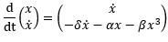
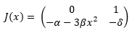
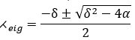
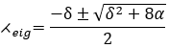
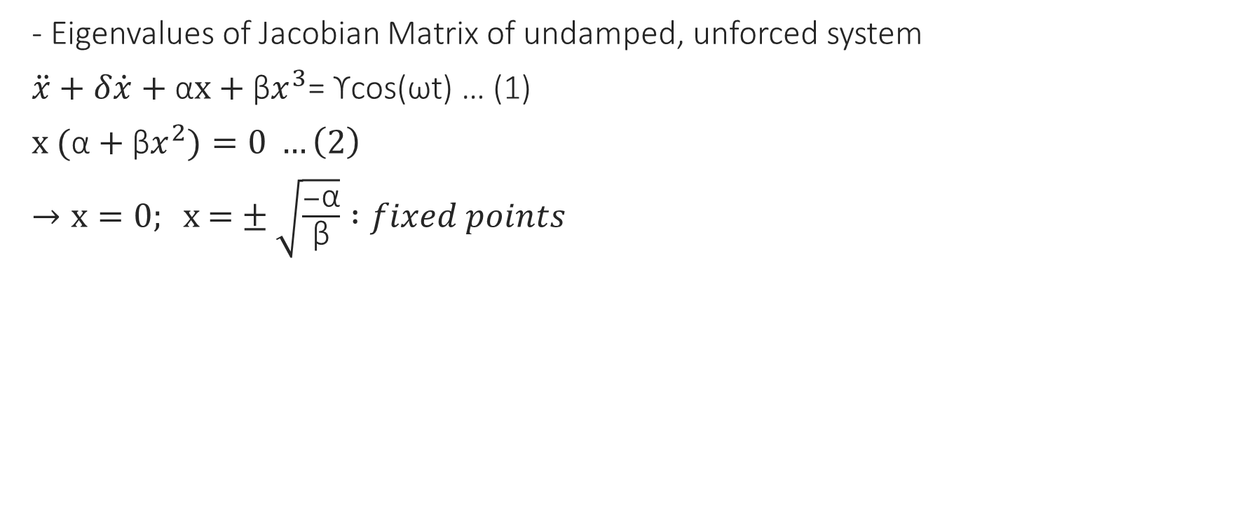
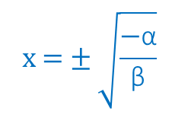
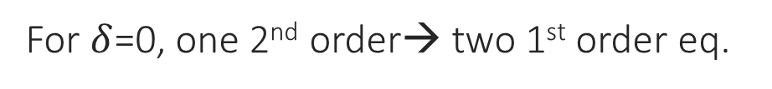

Stability Check
- Eigenvalues of Jacobian Matrix of undamped, unforced system
$\ddot{x}+δ\dot{x}+\text{α}x+{\text{β}x}^{3}$= ϒcos(ωt) … (1)
$x \text{(}\text{α}+{\text{β}x}^{2})=0 …\left(2\right)$
$→x=0; \text{x}\text{ =}±\sqrt{\frac{−\text{α}}{\text{β}}} :fixed points$
For $δ$=0, one 2nd order→ two 1st order eq.
$$\text{x}\text{ =}±\sqrt{\frac{−\text{α}}{\text{β}}}$$
$$x=0$$
Notes:
(2) No net force (conservation of energy)
at x = 0 , always equilibrium point (fixed point) exists
at x= +/- sqrt(-alpha/beta), two equilibria appear. → Jacobian
Jacobian: take derivative w.r.t. x and x’

Slide 5
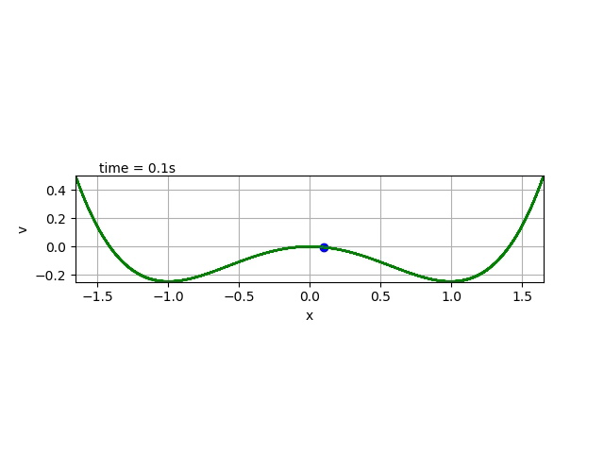
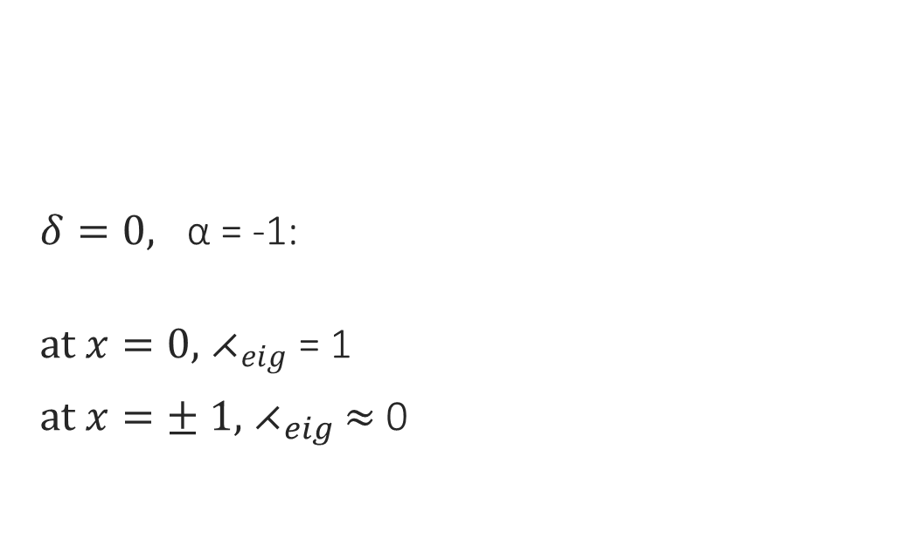
Stability Check
$δ=0, \text{α}\text{ = −1:}$
$at x=0,{ ⋌}_{eig}$ = 1
$at x=± 1,{ ⋌}_{eig}$ $≈$ 0
Notes:
Complex -> take real part ~ 0

Slide 6
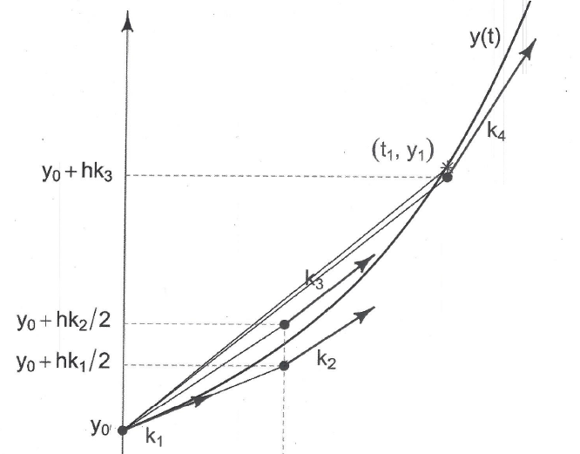
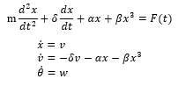
Numerical Approximation
Fourier Series, Frobenius method, Homotopy analysis method (HAM)
4th order Runge-Kutta Method
application:
Table 1 Fourth-order Runge-Kutta Implementation Verification^{[1]}
Step size (h) | Approximation of x at t = 0.1, x_{approx} | Final Global Error(F.G.E) at t = 0.1 (x_{approx}- x_{true}) | Error Ratio
0.1 | -0.0018921715207243900 | -0.0000000076565361900 | -
0.05 | -0.0018921642988212700 | -0.0000000004346330700 | 17.6
0.025 | -0.0018921638899839600 | -0.0000000000257957601 | 16.8
0.0125 | -0.0018921638657577500 | -0.0000000000015695500 | 16.4
0.0001 | -0.0018921638641882000 (=x_{true}) | (assume true value) | -
Figure 3. RK4 Method
Notes:
Since Duffing equation does not admit an exact symbolic solution,
Can use approximation methods numerically to determine solutions.

Slide 7
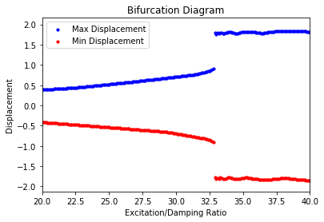
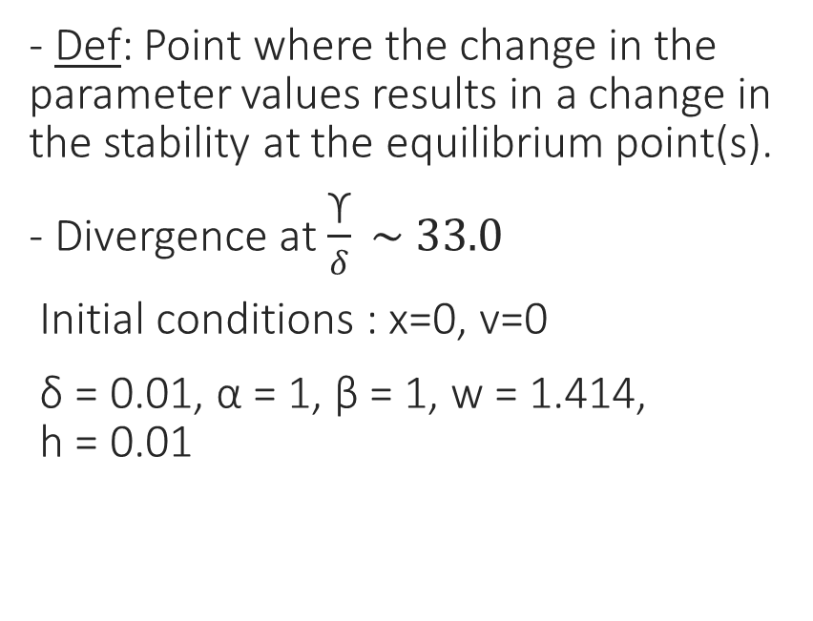
Bifurcation
- Def: Point where the change in the parameter values results in a change in the stability at the equilibrium point(s).
- Divergence at$\frac{\text{ϒ}}{δ} \sim 33.0$
Initial conditions : x=0, v=0
δ = 0.01, α = 1, β = 1, w = 1.414, h = 0.01

Slide 8
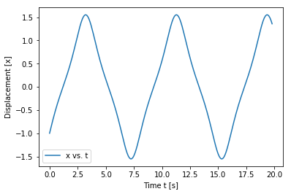
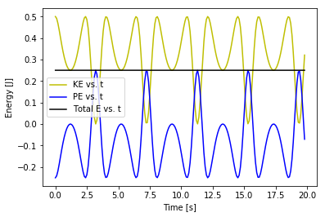
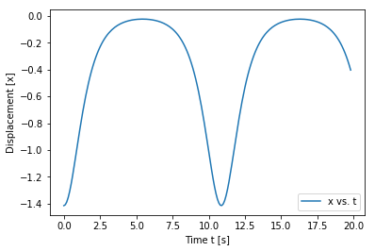
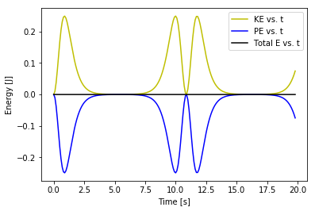
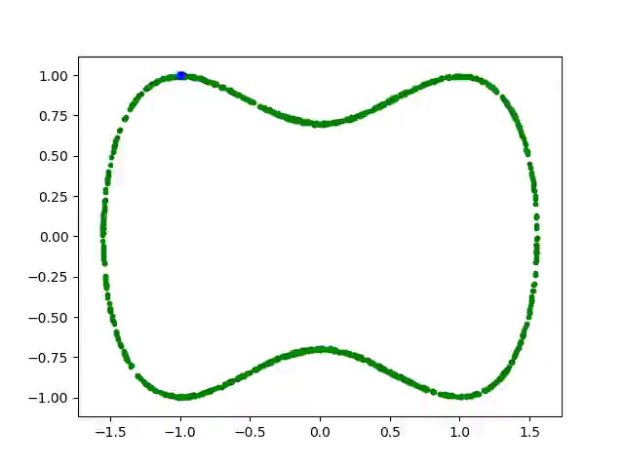
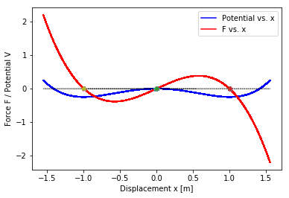
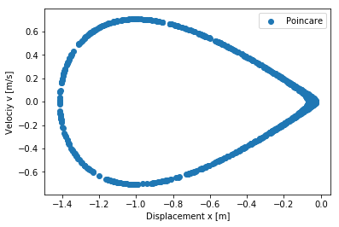
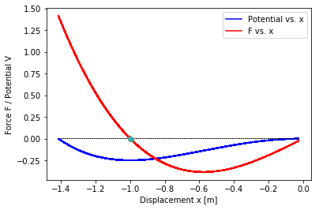

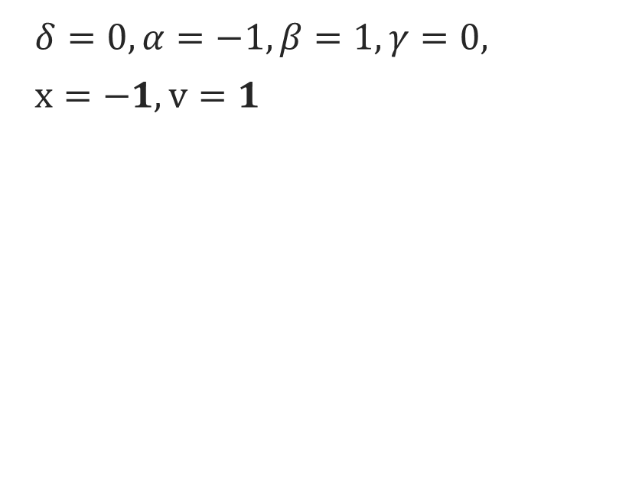
Free motion
$δ=0, α=−1,β=1,γ=0,$
$x=−1, v=1$
$$δ=0, α=−1,β=1,γ=0, \\ x=−1.414, v=0$$

Slide 9
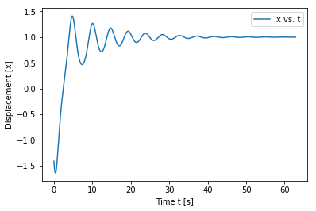
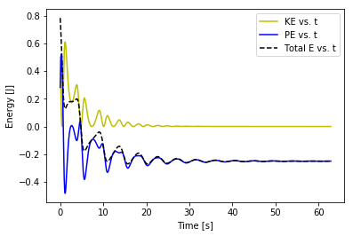
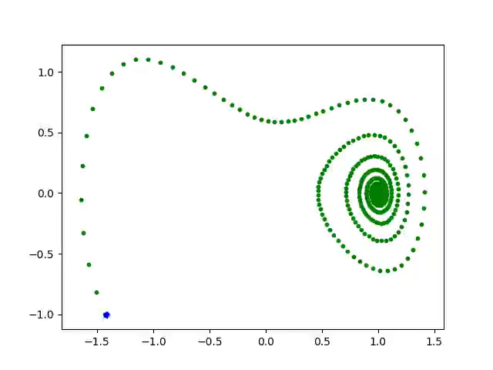
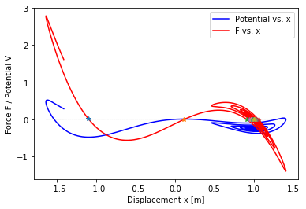
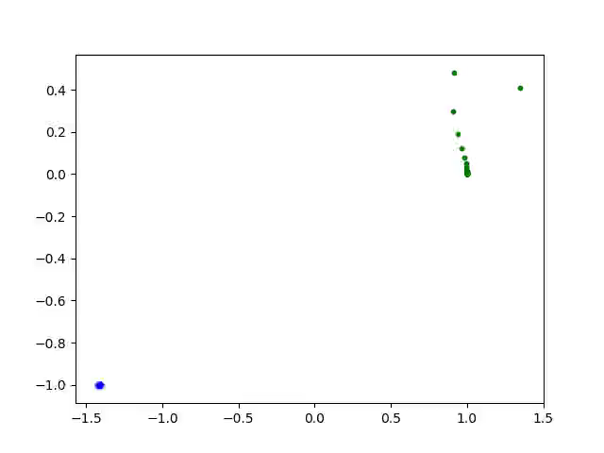

Damped Motion
$δ=0.2, α=−1,β=1,γ=0,$
$x=−1.414, v=−1$

Slide 10
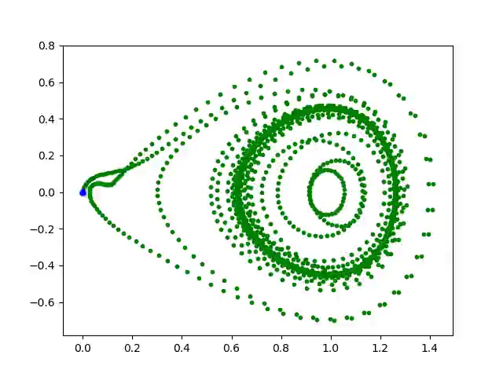
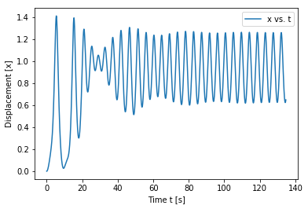
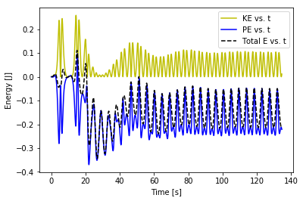
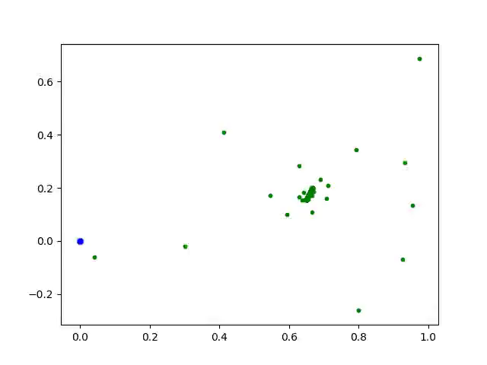
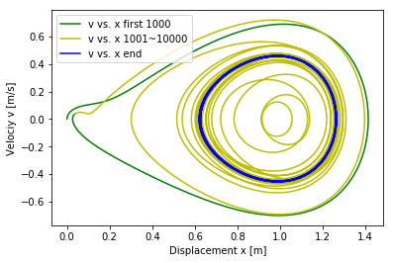
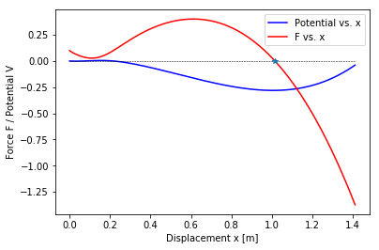
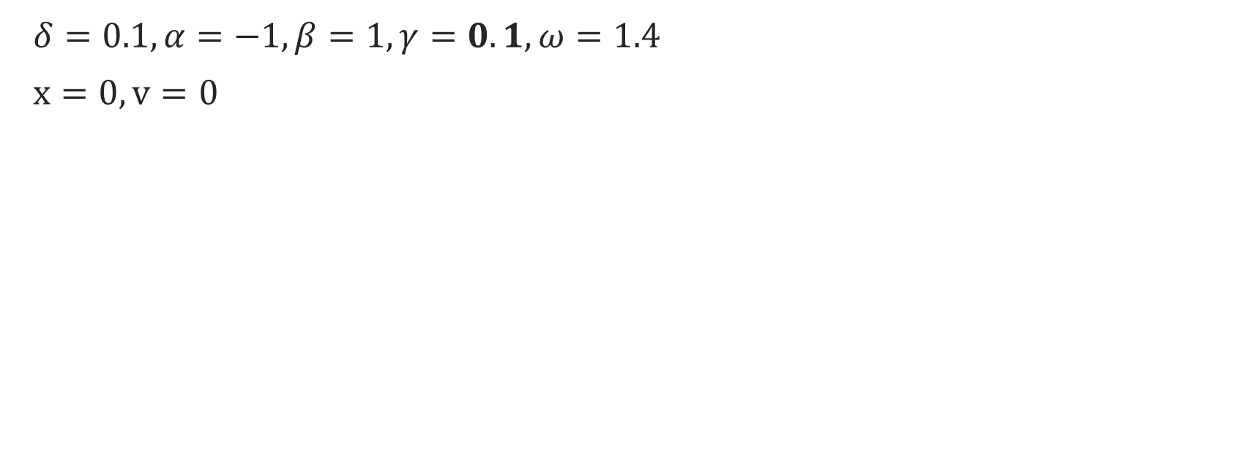
Damped Driven Motion
$δ=0.1, α=−1,β=1,γ=0.1,ω=1.4$
$x=0, v=0$

Slide 11
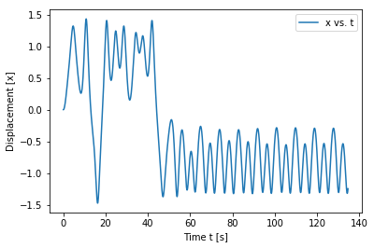
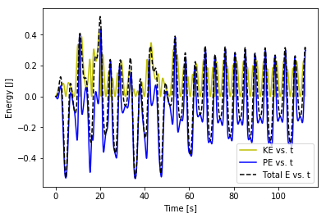
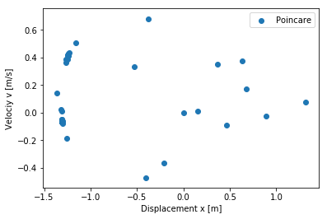
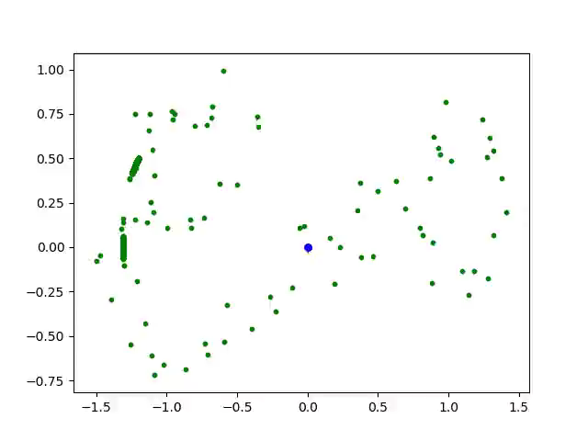
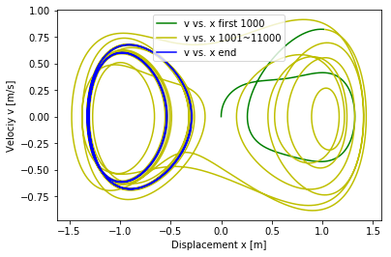
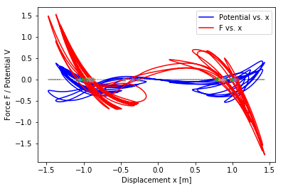
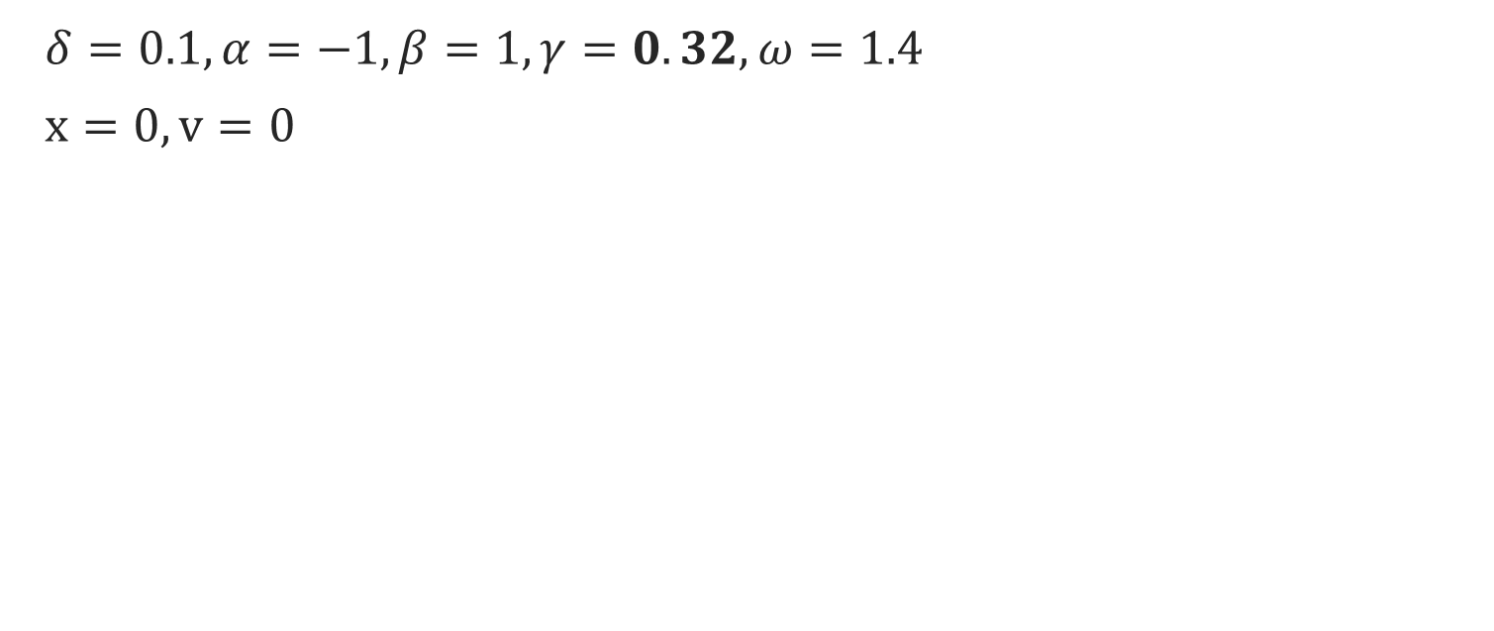
Damped Driven Motion - 2
$δ=0.1, α=−1,β=1,γ=0.32,ω=1.4$
$x=0, v=0$

Slide 12
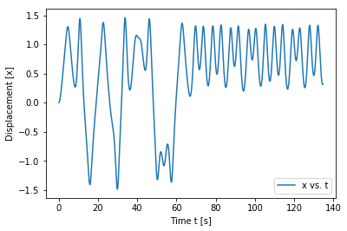
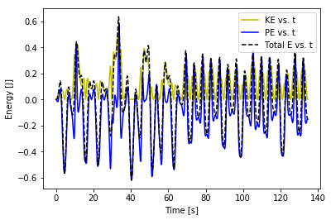
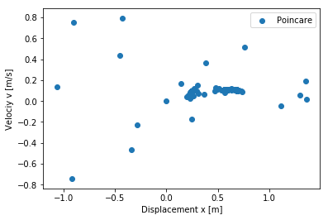



Damped Driven Motion - 3
$δ=0.1, α=−1,β=1,γ=0.34,ω=1.4$
$x=0, v=0$

Slide 13









Damped Driven Motion₄: Chaos!
$δ=0.1, α=−1,β=1,$
$γ=0.38,ω=1.4$, $x=0, v=0$

Slide 14








Frequency Response
* approach: harmonic balance method
(i) Linear System (point of bifurcation)
(ii) Softening System
(iii) Hardening system
Notes:
Image ref for the methods:
https://www.ila.uni-stuttgart.de/nlvib/downloads/HB_NLvib_presentation.pdf

Slide 15




scipy.integrate - ‘odeint’
(i) Single-Well
(ii) Double-Well

Slide 16

Visual (1D Motion)

